Slide 1

Baggage Threat Detection using YOLO
A Deep Learning Approach
Presented by: Mohamed Hamdy

Slide 2
Project objectives
Detecting potential threats in baggage after scanning using X-ray
Applying different versions of YOLO to detect prohibited items
Deploying the models using streamlit to work on real-world data

Slide 3
What is YOLO
YOLO stands for You Only Look Once
YOLO is a deep learning model used in real-time object detection in computer vision
There are different versions of YOLO starting from YOLOv1 up to YOLOv12

Slide 4

Dataset overview

Slide 5
Dataset description
Dataset Purpose: Contains images of baggage scanned using X-ray, including prohibited items, for an object detection project.
Dataset Split: Divided into train, test, and validation sets.
Classes: Gun, Knife, Pliers, Scissors, Wrench
Folder Structure: Each set includes two folders:
Images: X-ray scans of baggage.
Labels: Annotations for object detection (bounding boxes and class labels for prohibited items).

Slide 6
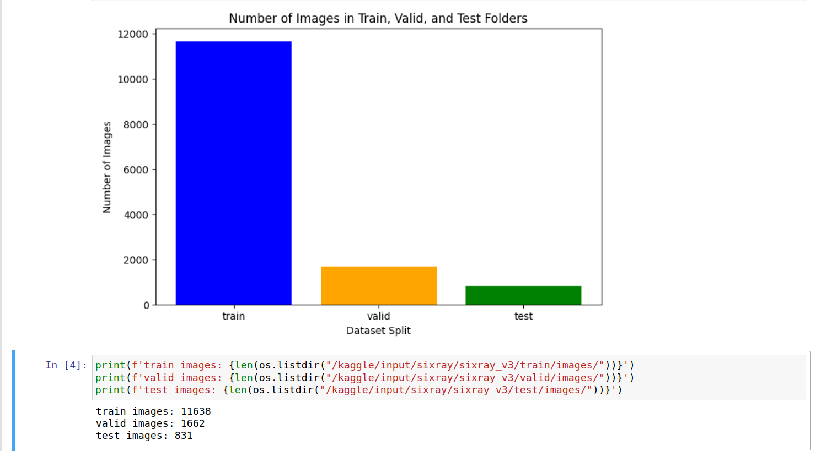
2. Dataset Distribution

Slide 7
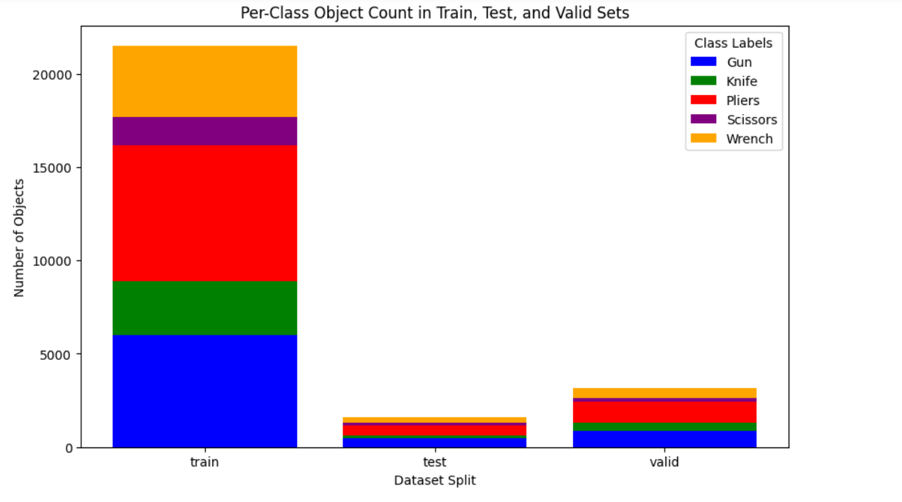

Slide 8
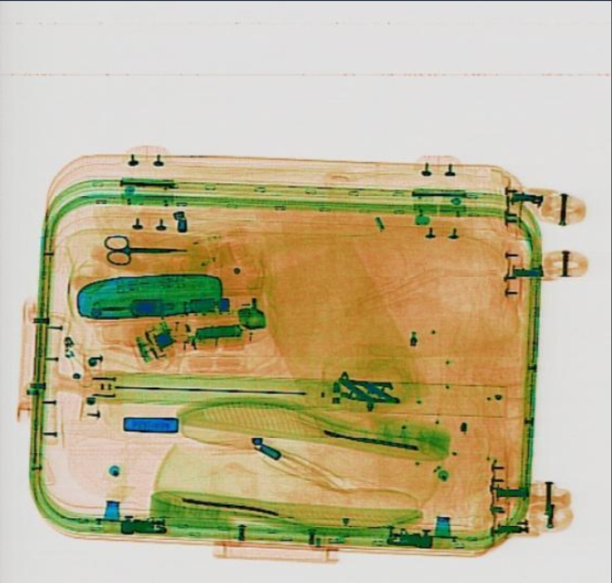
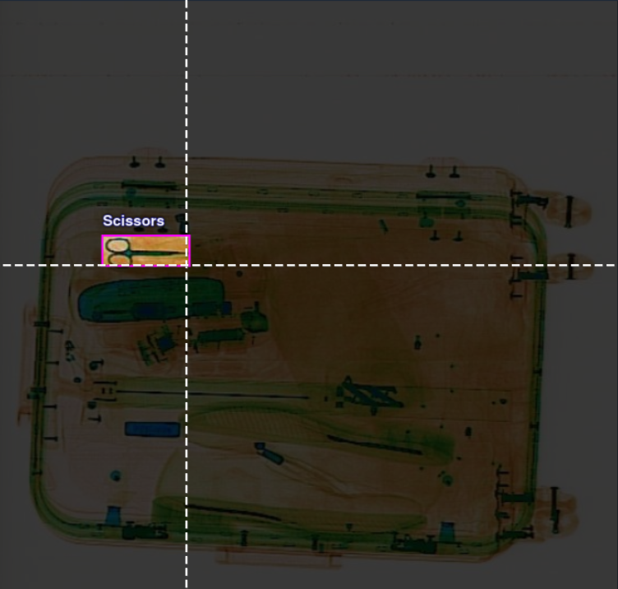
3. Dataset sample

Slide 9
4. OOD (Out-of-Distribution) Dataset
Definition: collection of data that is different from the data used to train the model
Source: Collected from diverse online sources to simulate real-world baggage X-ray scans
Purpose: OOD images show how well the model performs on unseen data, so evaluate its generalization to real-world scenarios.

Slide 10
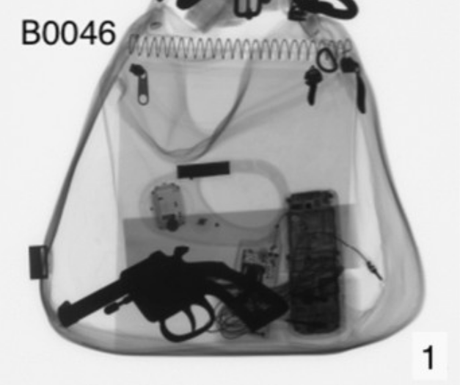
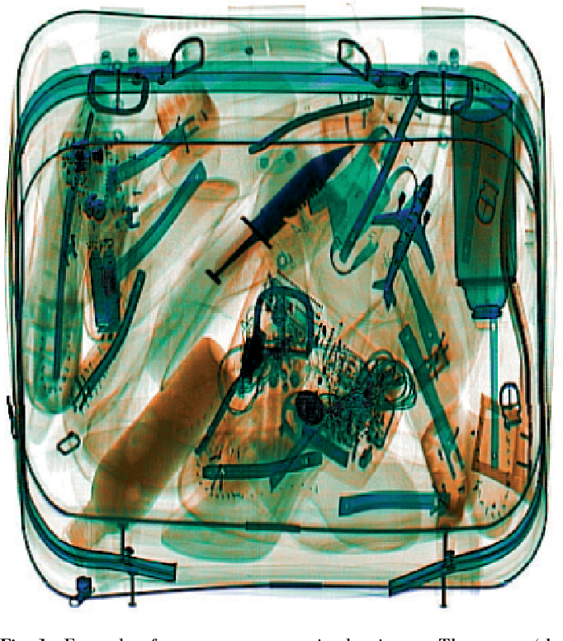
5. OOD Dataset sample

Slide 11
6. Dataset links
Sixray dataset: https://universe.roboflow.com/khanhs/sixray-yg9ii
Augmented sixray dataset: https://www.kaggle.com/datasets/khanhbtq99/sixray
OOD dataset: https://www.kaggle.com/datasets/mohammedhamdyy/bag-threats

Slide 12
YOLO Model

Slide 13
Model definition and hyperparameters selection

Slide 14
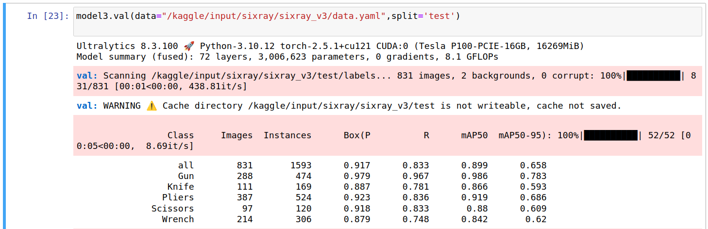
2. Model's performance

Slide 15
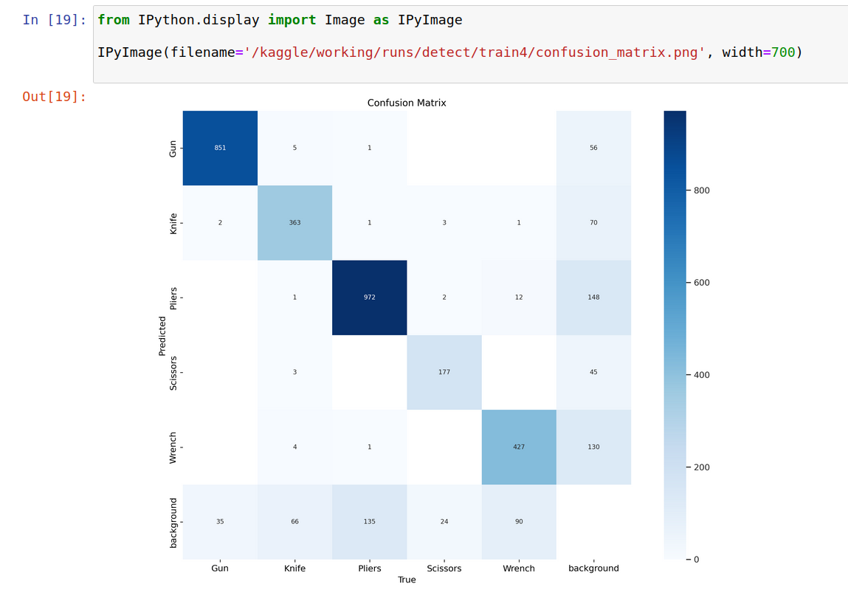

Slide 16
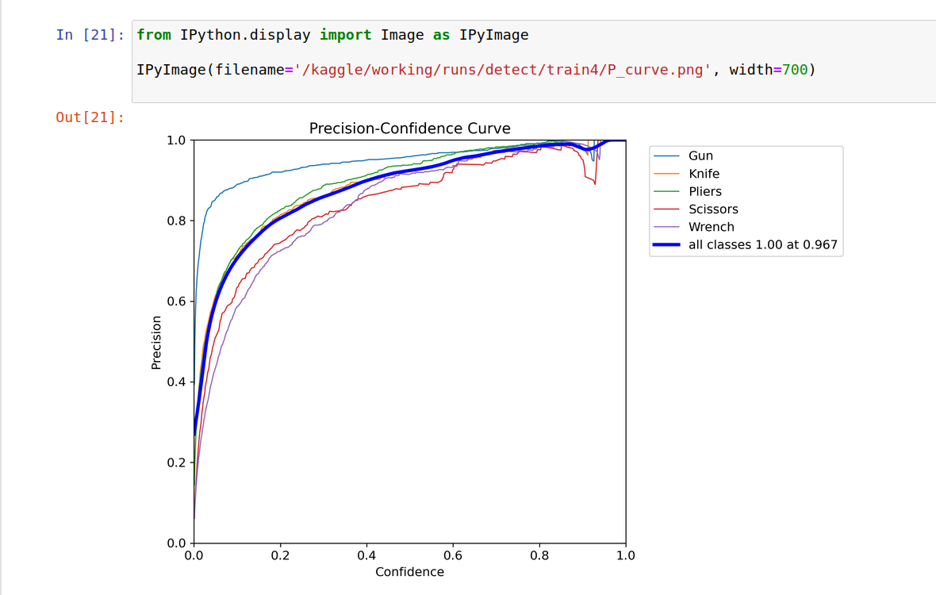

Slide 17
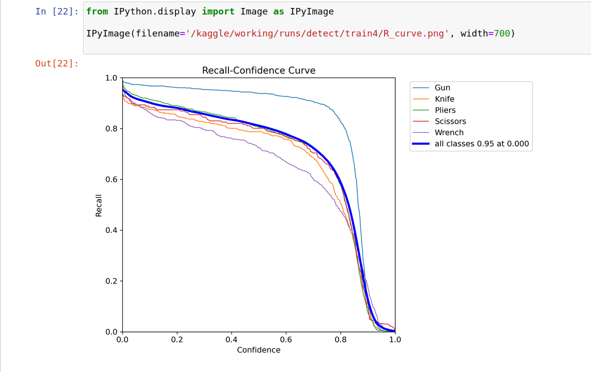

Slide 18
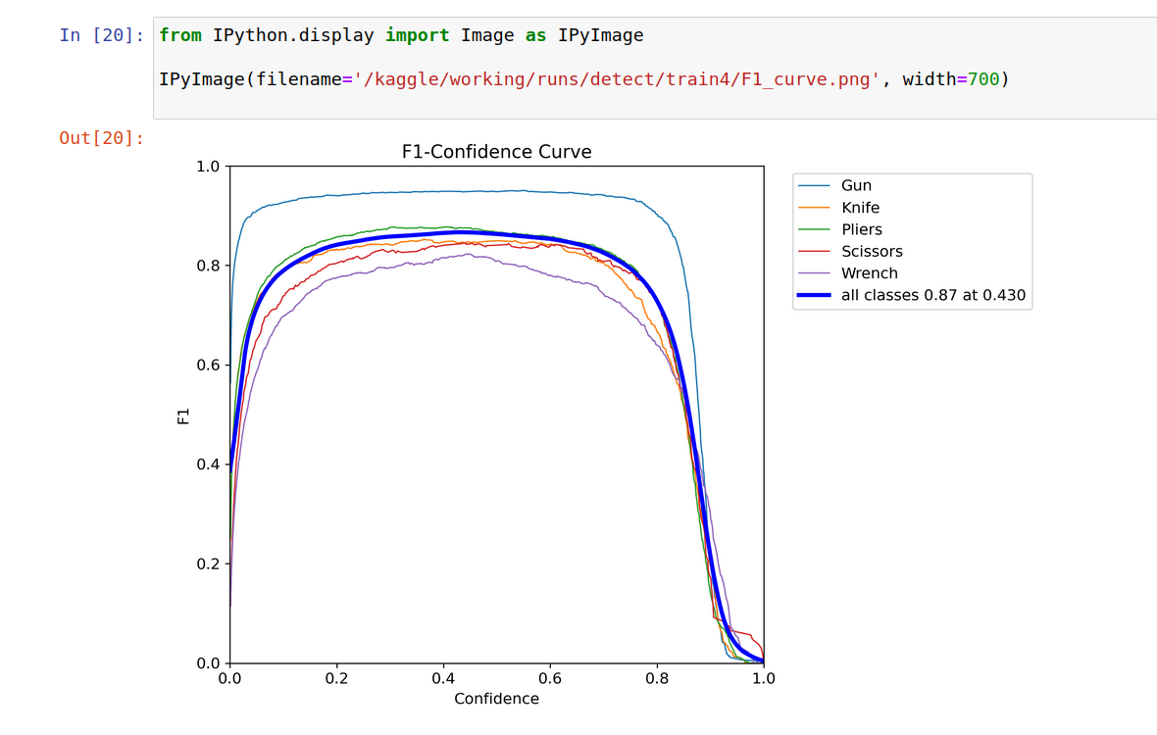

Slide 19
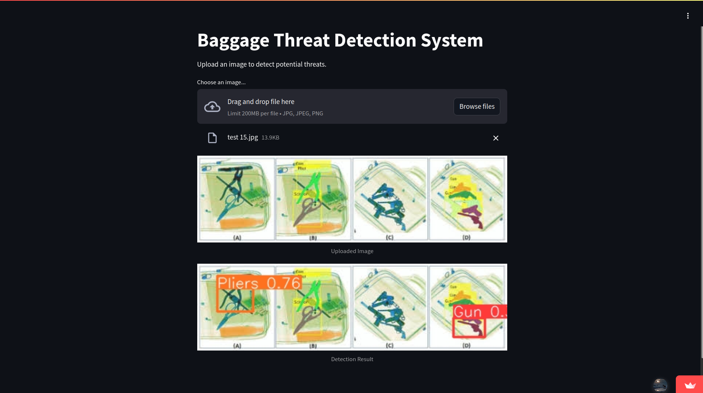
3. Model deployment

Slide 20
4. Links
Notebooks: https://github.com/ayamotawea/Baggage-Threat-Detection-using-X-ray/tree/main
Streamlit application: https://baggage-threat-detection-using-x-ray-9qljxz4khyyyk5fgfwx2dt.streamlit.app/

Slide 21
NexaAI Team members
Mohamed Shorky Raslan
Aya Motawea
Mohamed Hamdy Zaki
Nora Mohammed Abdel Halim
Shimaa Kamal Mohamed Nasr

